Slide 1

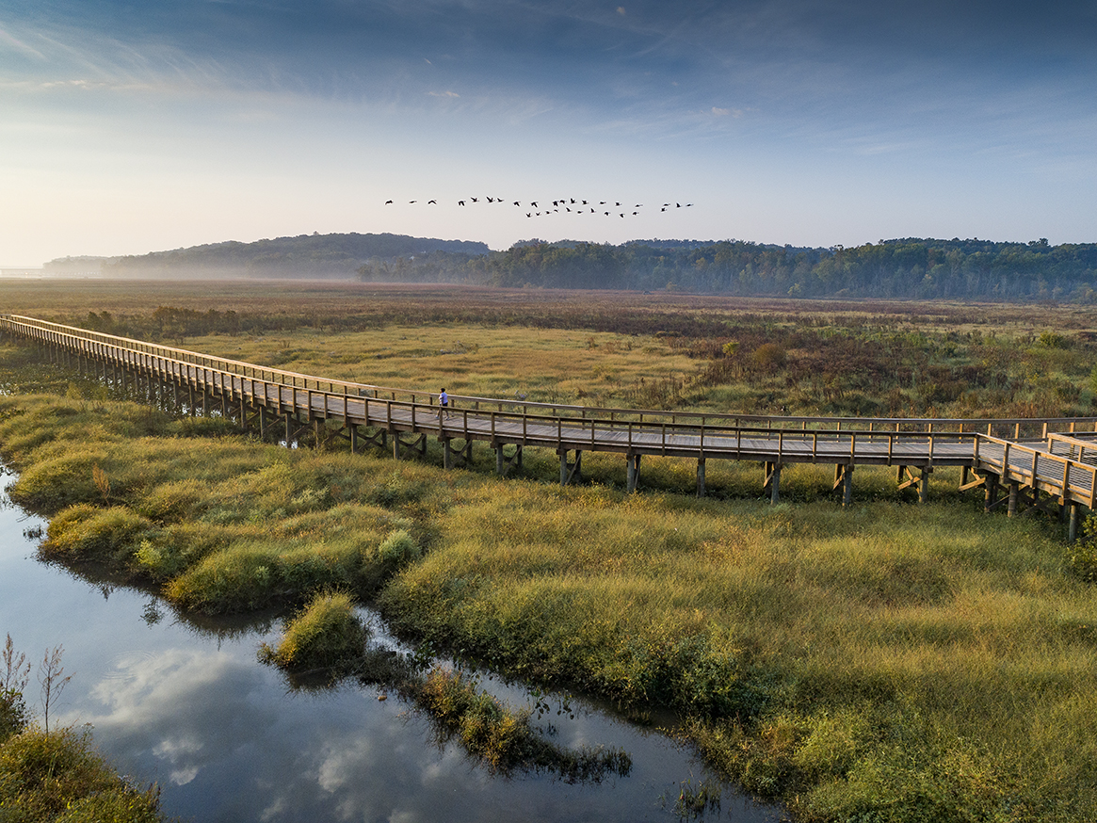
Occoquan Creek Sewage Pumping Station
Construction Target Date: July 2026
Belmont HOA
November 18, 2025

Slide 2

Prince William Water
Provides Clean Drinking Water
Treats Wastewater for Prince William County
Maintain over 22 Water Storage tanks
Operate 67 Wastewater Pump Stations
Manage over 12,000 fire hydrants
Run 16 Water Booster Stations
Invest in long-term infrastructure improvements-Capitol Improvement Project (CIP)
Notes:
Rony Avalos

Slide 3
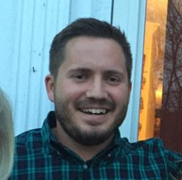
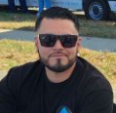

Team
Alex Silver- Deputy Director of Project Management Office, CCM
6 Years with Prince William Water
Prince William County Resident
Completed projected SPS Projects, Water Main Projects etc.
Rony Avalos-Project Manager, CMIT
2 Years with Prince William Water
Water Storage Tank program
Prince William County Resident
Reza Emtiaznoori- Senior Project Manager, PE, GHD
25 Years of Experience
Participated in the design of more than two dozen water and
sewer pumping stations
Notes:
Rony Avalos

Slide 4
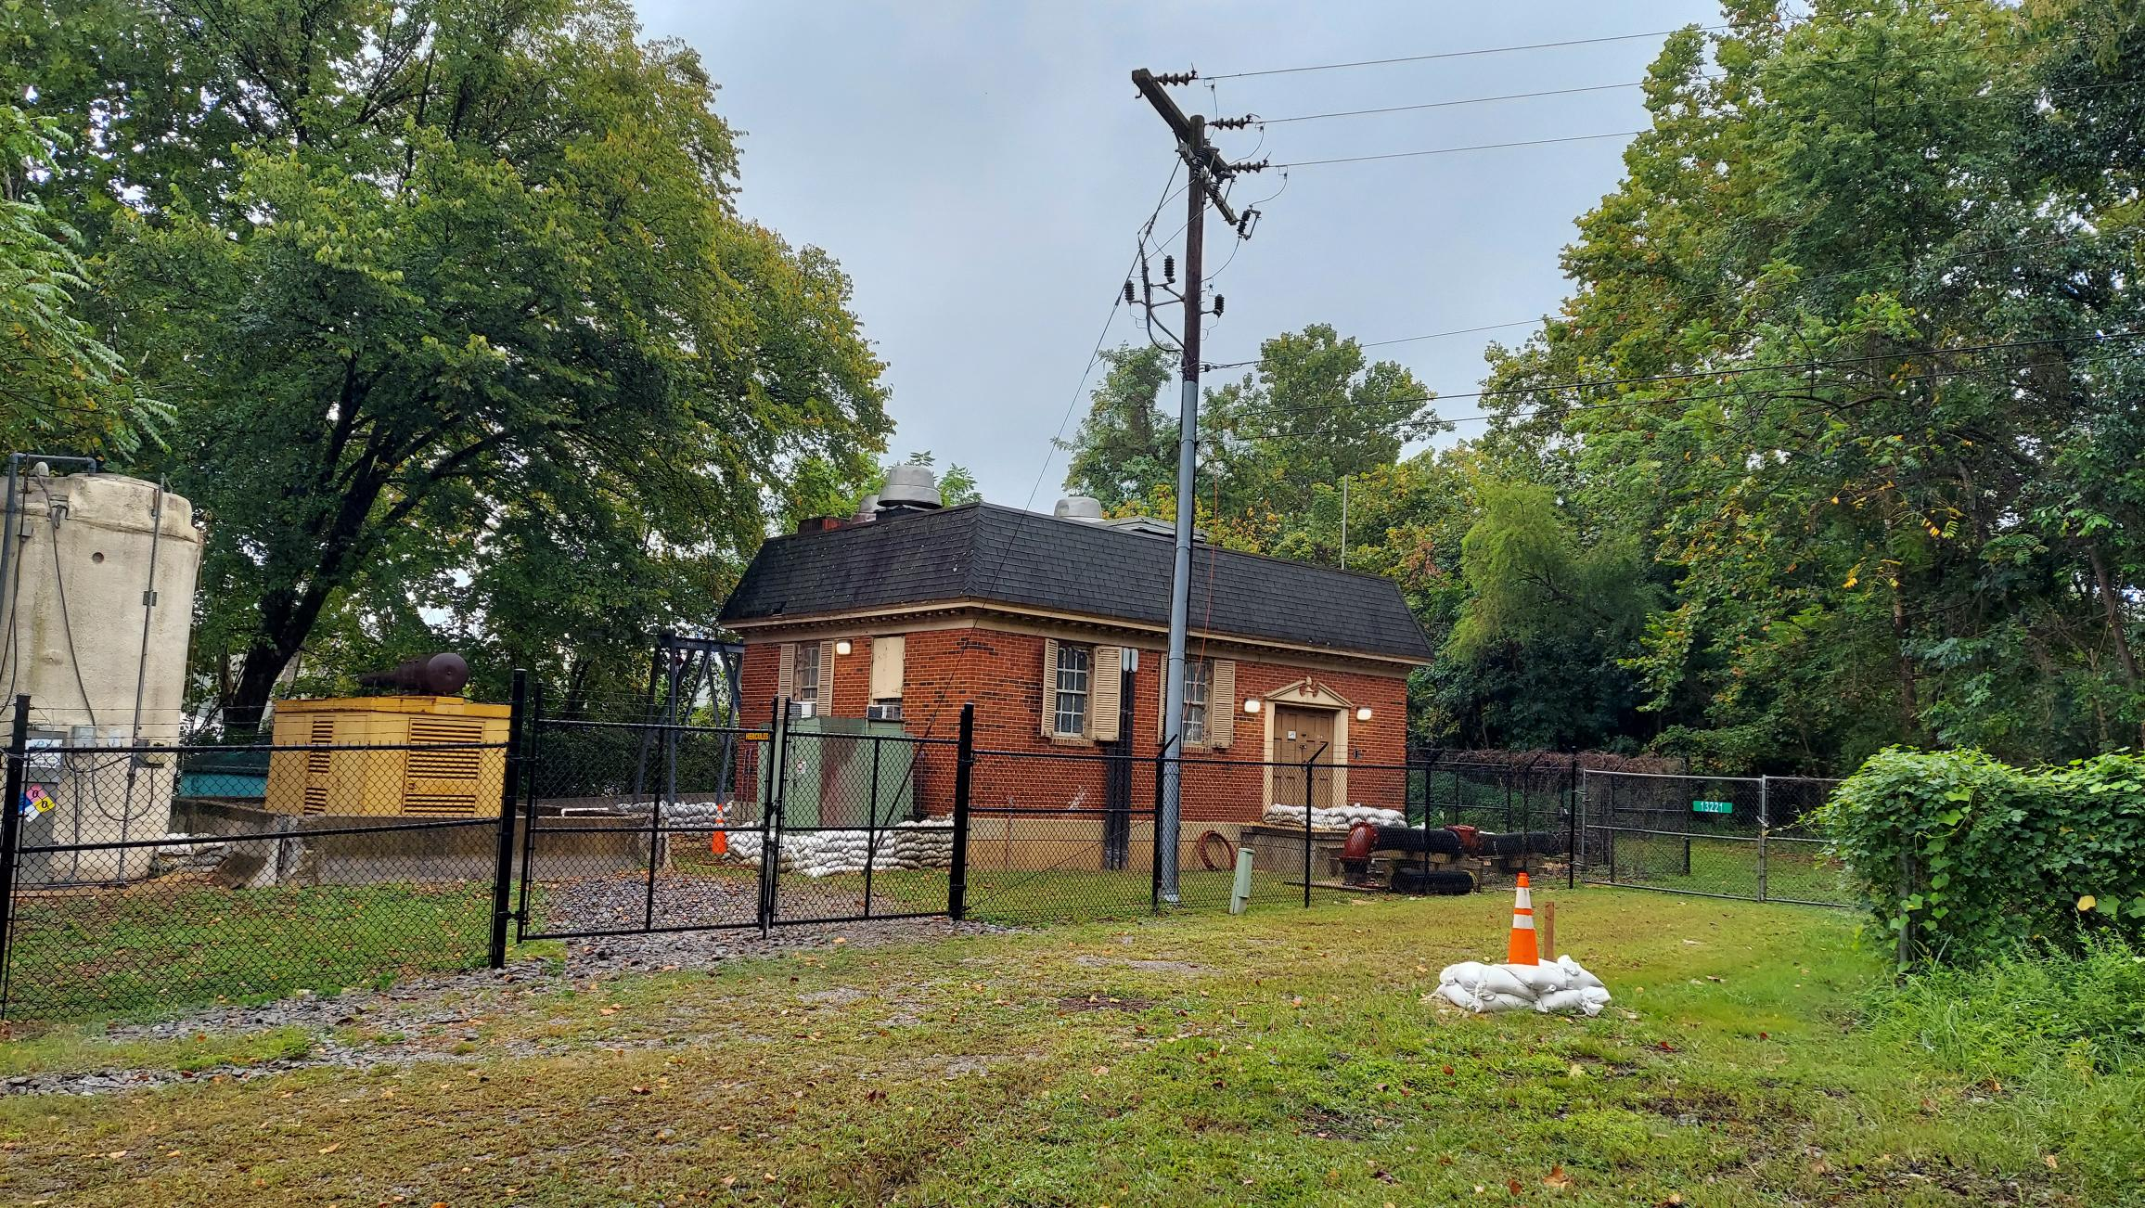
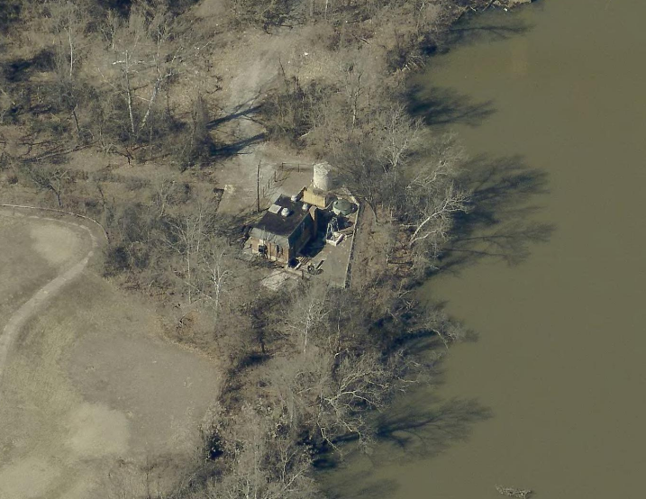
Existing Pumping Station
Constructed in 1975.
Rated Capacity 16 MGD.
Aging infrastructure.
Affected by flooding from Occoquan River.
Shore Erosion.
Condition Assessment in 2018.
Capacity upgrade.

Slide 5
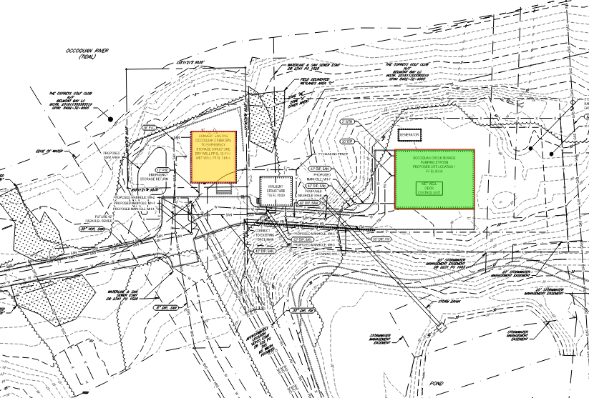
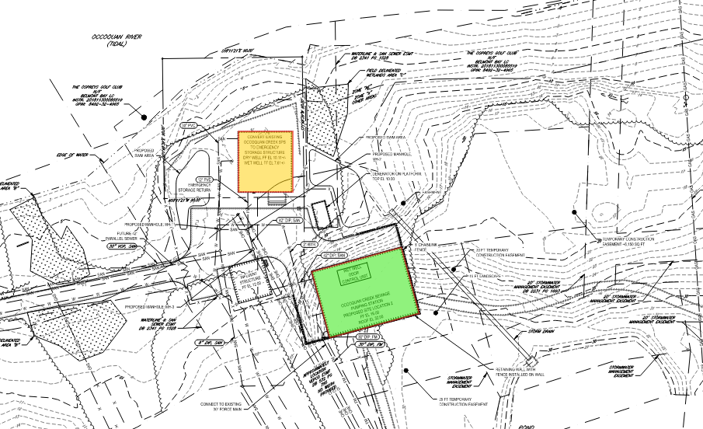
New Pumping Station: Location
ALTERNATIVE 1
Considered two locations to meet necessary requirements:
Updated and more efficient equipment and building.
Meet current codes, standards, and PW Water Utility Standard Manual.
Meet future capacity of 17.28 MGD.
Elevated odor control.
Alternative 2 was chosen.
ALTERNATIVE 2

Slide 6
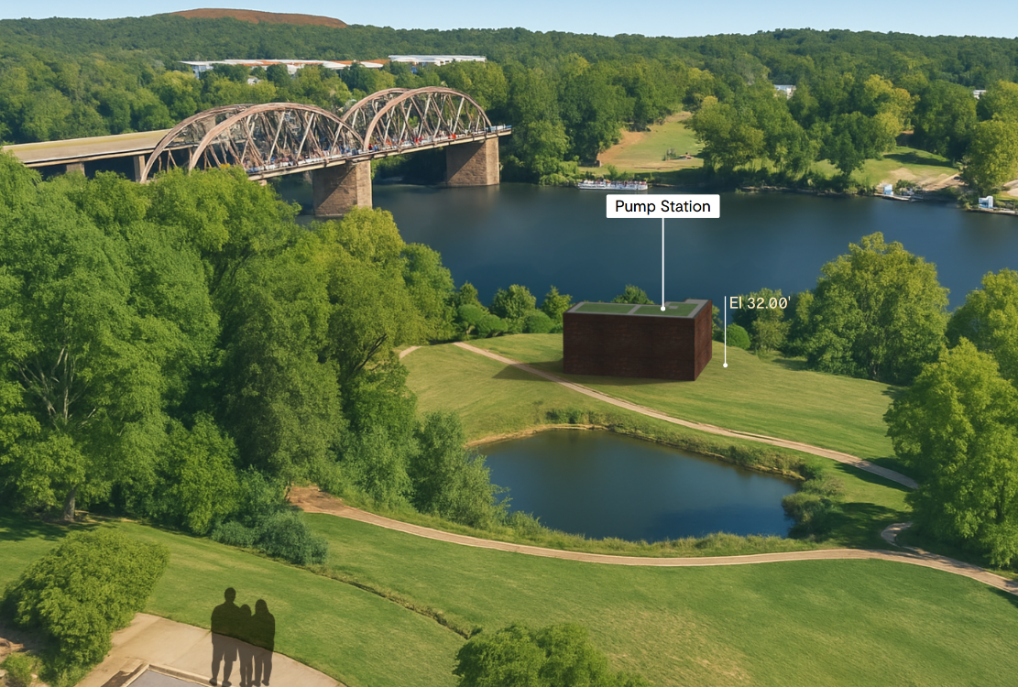
3D View of Pumping Station (Alternative 1)

Slide 7
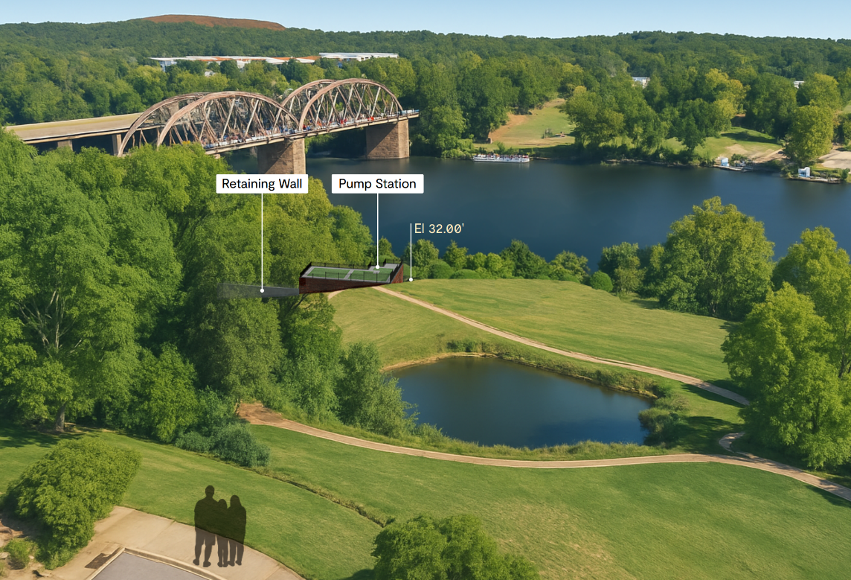
3D View of Pumping Station (Alternate 2)

Slide 8
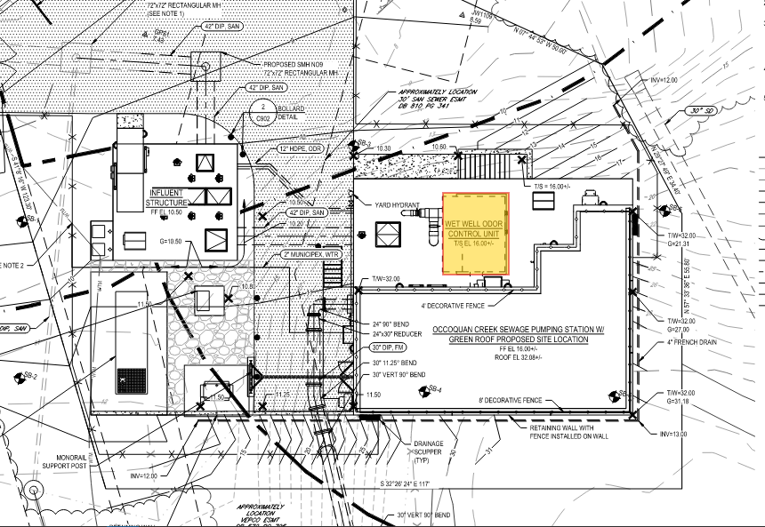
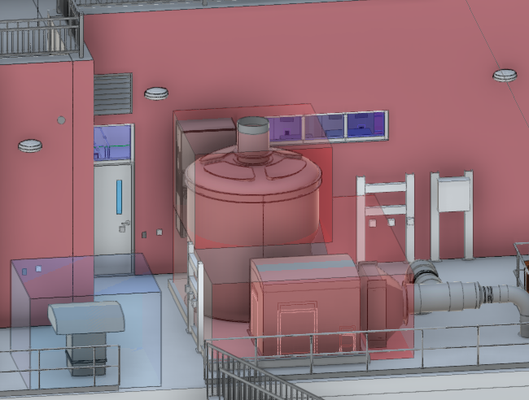
New Pumping Station: Benefits
More visually discrete.
Away from Occoquan River shoreline.
Elevated above Floodplain.
Odor Control.
Activated Carbon
Design
99.5% Hydrogen Sulfide removal
95% incoming odor
Sound enclosure
Less retention time => Less Odor

Slide 9
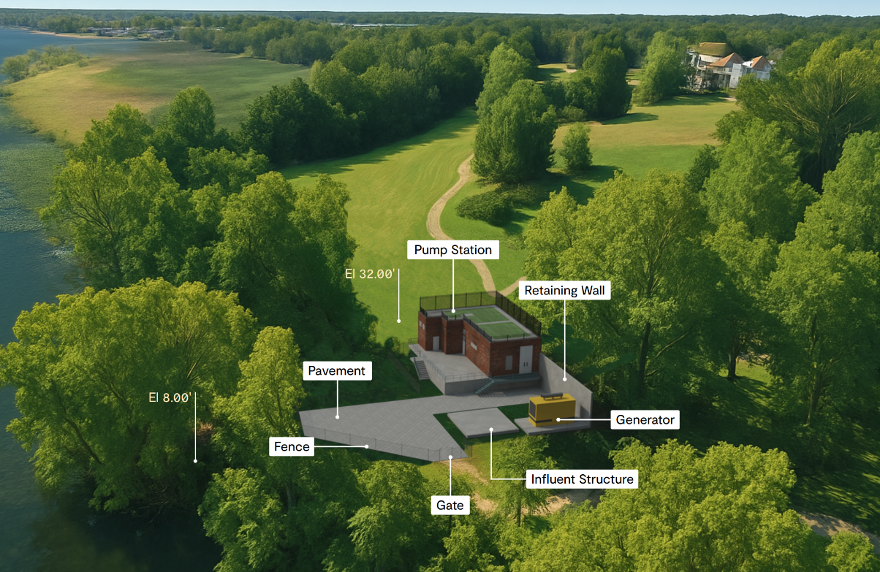
3D View of Pumping Station

Slide 10
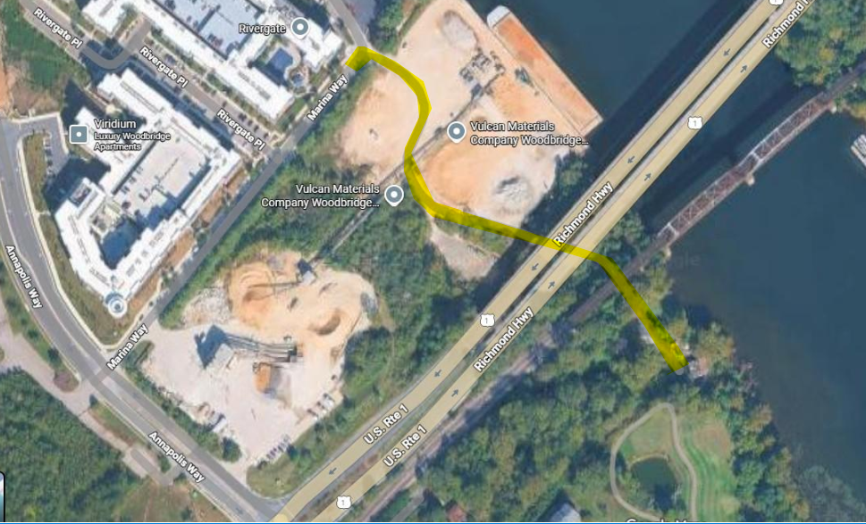
Targeted Construction Schedule
Phase | Duration | Key Activities
Pre-Construction | 2 Months | Permits, E&S meeting, Mobilization
Procurement & Submittals | 15 Months | Shop drawings, fabrication, equipment delivery
Construction | 23 Months | Excavation, concrete work, structure build, MEP installs
Commissioning & Closeout | 3 Months | Testing, start-up, demolition, restoration

Slide 11
Upcoming Meetings
January Public Meeting
Construction Notification Letter
Website Link: https://princewilliamwater.org/our-community/capital-projects#highlighted-projects
Contact Information:
Rony Avalos, Project Manager, ravalos@pwwater.org
Alex Silver, Deputy Director, asilver@pwwater.org

Slide 12

Questions?

